Slide 1
ADDRESSING TECHNICAL DEBT (TD) THROUGH SCENARIO‑BASED DEVELOPMENT (SBD): a cost‑driven approach
Sabina Amaricăi (Founder BRIDGE IN TECH, Dublin, Ireland)
Radu Constantinescu (ASE, Bucharest)
Antonio Clim (ASE, Bucharest)
Notes:
Good afternoon, everyone.
Technical Debt, a term introduced by Ward Cunningham, reflects the hidden costs we incur from short-term development choices.
Our research offers a structured solution through Scenario-Based Development, or SBD, combined with clear cost metrics, to effectively manage Technical Debt in software projects.
So, today I will present our research on managing technical debt through a structured, cost-driven scenario-based approach.
Think of it (about this research) as the 'buy now, cry later' plan of software development.
And just in case you're wondering, yes, we learned this the hard way—because there's no better teacher than painfully personal experience.

Slide 2
INTRODUCTION TO TECHNICAL DEBT (TD)
Definition: Short-term coding shortcuts causing long-term maintenance costs (interest).
Importance: High maintenance, decreased productivity, reduced software quality.
Technical Debt undermines product quality and slows delivery.
Ad‑hoc decisions amplify long‑term maintenance costs.
Need quantifiable, scenario‑specific evidence to prioritise TD.
Notes:
Technical Debt is analogous to financial debt—early shortcuts lead to accumulating interest, increasing long-term costs.
In Agile methodology is similar:
Technical Debt refers to compromises/shortcuts made during software development.
These compromises initially speed up delivery but result in higher future costs.
These shortcuts seem helpful at first, but later cause extra work, higher costs, and quality problems.
These hidden costs accumulate, significantly affecting productivity, quality, and budgets.
Technical Debt is like ordering fast food: quick, satisfying now, but you'll regret it later.

Slide 3
RESEARCH OBJECTIVES (search & fit for)
Organizational & communication barriers
Effective metrics for measuring TD impacts
Scenario-Based Development (SBD) approach
Notes:
Our research aims to address/uncover three key (related) issues:
1) the organizational and communication barriers in teams (preventing effective TD management),
2) developing clear metrics for quantifying TD impacts,
3) validating Scenario-Based Development as a structured, integrative solution (thus, SBD as a cohesive solution).
Rephrased:
Our research focuses on understanding why teams struggle with Technical Debt, creating simple metrics to measure its impact and showing how SBD helps teams manage this debt effectively.

Slide 4
OBSERVED CHALLENGES
Role-based misalignment: developers, product managers, architects
Lack of structured TD evaluation and clear metrics
Consequences: disengagement, higher costs, lower quality
Notes:
We noticed teams often have problems because roles like developers, managers, and architects think differently about priorities.
Without clear communication, this leads to confusion, frustration, higher costs, and lower-quality software.
Rephrased:
In our observations across diverse software Agile teams, we’d seen:
role misalignment &
lack of clear metrics
All emerged as significant issues, leading to disengagement, increasing costs & reduced software quality.
It's like trying to renovate a house while still living in it—dust everywhere and nothing works properly.

Slide 5
SCENARIO-BASED DEVELOPMENT (SBD) as solution
Integrated method: linking user scenarios to measurable outcomes
Elements: Scenarios, Actors, Actions, Goals
Notes:
We propose Scenario-Based Development to align diverse team roles by clearly connecting user scenarios to quantifiable Technical Debt outcomes, creating shared understanding and facilitating informed decisions.
Rephrased:
Scenario-Based Development helps teams clearly connect user needs to specific Technical Debt tasks.
It provides a common language everyone understands, making decisions about debt easier and clearer.

Slide 6
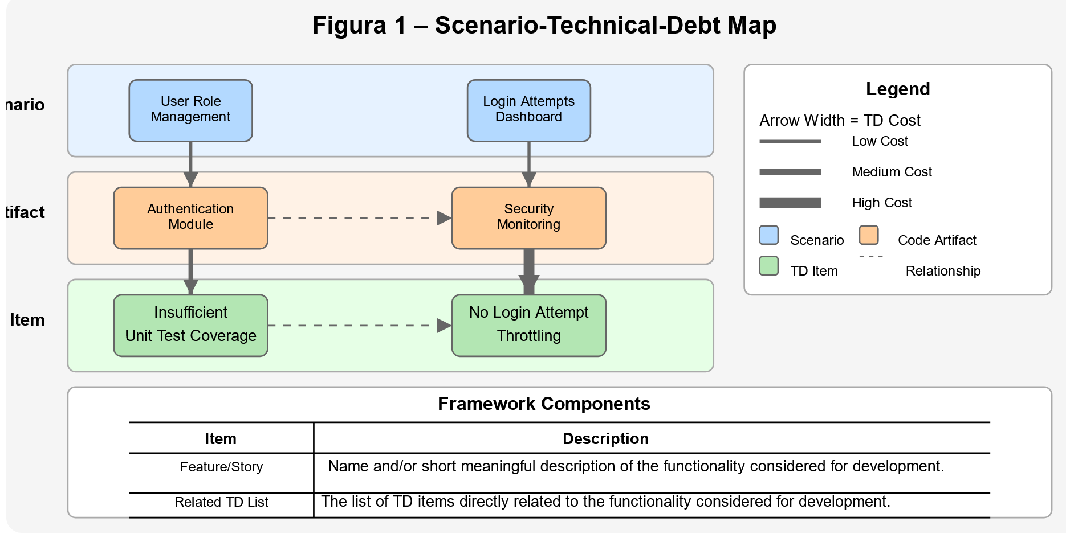
SCENARIO-BASED DEVELOPMENT (SBD) figure
Notes:
This diagram visually shows how each user scenario is directly linked with specific Technical Debt items, helping teams prioritize and discuss clearly.
This diagram is like a family tree of your code's bad decisions—it's complicated and a bit embarrassing.

Slide 7
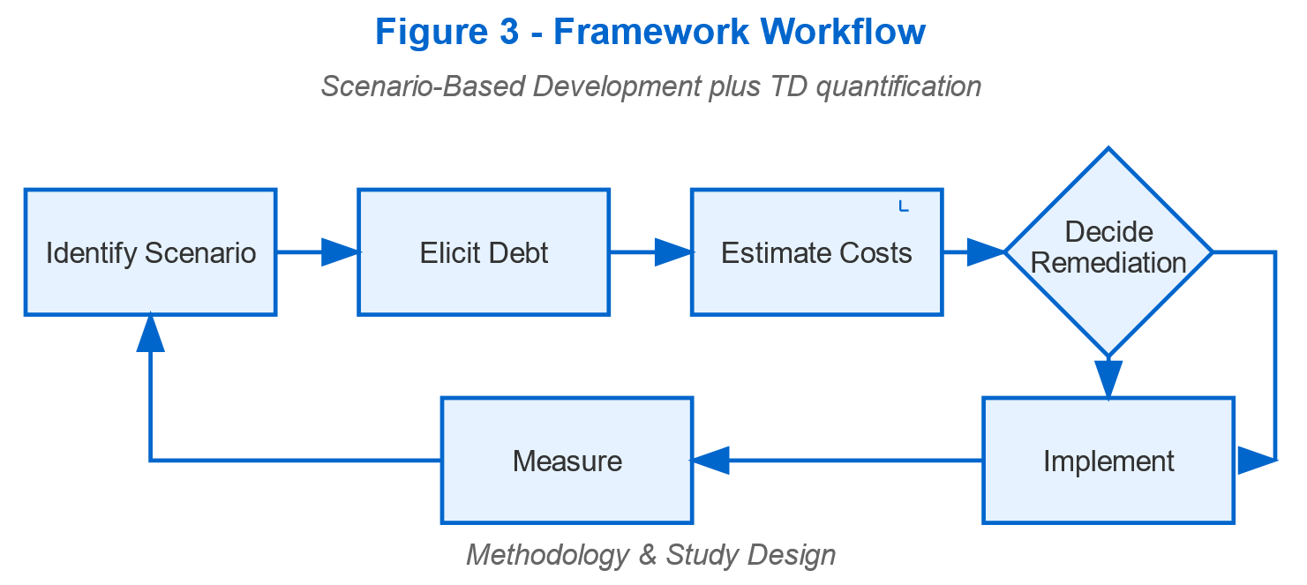
Cost-Driven FRAMEWORK overview (part ½)
Basic Metrics Explained: STORY COST (basic effort for a new feature), TD COST (effort to fix a specific technical debt issue before adding new features), STORY COST with TD FIX (effort needed when fixing the debt and adding a feature together).
Notes:
Our framework introduces clearly defined metrics such as Story Cost, TD Cost, and the Story Cost when addressing Technical Debt immediately, providing clarity for all stakeholders.
We use simple metrics based on the Fibonacci scale, common in Agile teams, to measure effort.
For example, Story Cost is the basic effort needed for a feature, while TD Cost measures effort to fix debt separately.
With other words: above workflow details the structured process, emphasizing the significant benefits of resolving TD early to minimize future costs.

Slide 8
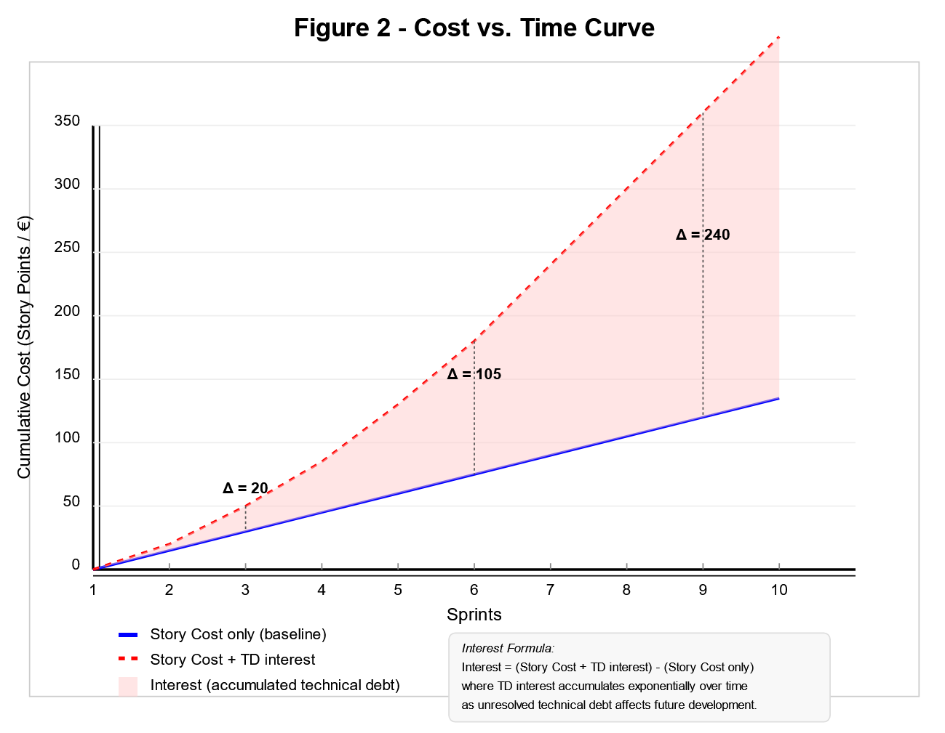
Cost-Driven FRAMEWORK overview (part 2/2)
Additional Metrics Explained: STORY COST if previously solved (effort if Technical Debt was fixed earlier), INTEREST (extra future effort if Technical Debt is not fixed now)
Notes:
Our workflow from trough of COST vs TIME underlining the increased interest (accumulated TD) per sprint.
Further metrics include the hypothetical Story Cost if TD were already resolved (BLUE ABSELINE), Story cost + TD interest (RED POINTED)
The difference resulting as:
INTEREST—the extra effort that teams might face in future sprints if they delay fixing the Technical Debt.
For example, not solving a small issue today might mean extra complexity and higher costs later.
With other words (less fancy) about interest:
Consider what the cost would be if debt was already solved earlier, reducing current effort.
'Interest' represents extra effort in the future if we delay fixing the Technical Debt now.
Interest on Technical Debt is like gym memberships—you pay for it, but the benefits are only realized if you actually do something.

Slide 9
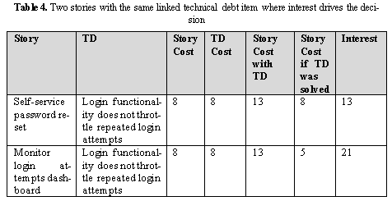
Practical Example – Login Scenario
TD example: Fixing insufficient unit test coverage linked to login functionality
Metrics shows clear benefits of immediate fixing.
Notes:
Practical example - adding a login feature.
Normally, it takes '8' points of effort.
Fixing insufficient unit tests separately needs '3' points.
Doing both together totals about '13' points.
Fixing this immediately avoids higher future costs.
Here, we clearly illustrate the substantial cost savings achieved by addressing Technical Debt promptly.
PS. Remainder: all costs are Fibonacci values! (Story cost has to be Scrum Master’s decision)

Slide 10
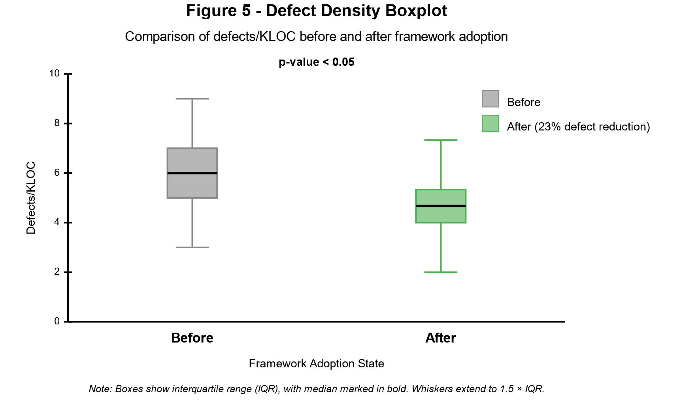
Case Study – Fintech Database Integration (part 1/4)
Problem Context: TD during database migration (poor design, lack of testing)
Application of the SBD (our) framework
Notes:
In a real-world fintech scenario, our framework guided the effective resolution of technical debt during a database migration.
This resulted in measurable improvements:
predictability increased significantly
defect density notably decreased,
Resulting in a clear validation of our structured approach.
Note: KLOC = Thousand (Kilo) Lines of Code

Slide 11
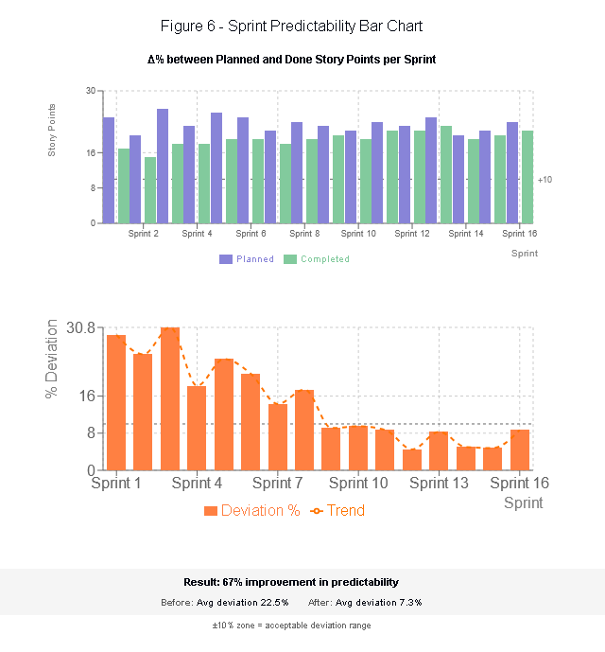
Case Study – Fintech Database Integration (part 2/4)
Clear improvements:
better planning accuracy,
fewer software defects.
Notes:
Applying the framework delivered measurable improvements, notably:
increased sprint predictability & accuracy
and
significantly lower defect density,
Thus, demonstrating substantial quality enhancements.

Slide 12
Further Results – Highlights
Case Study – Fintech Database Integration (part 3/4)
50% less effort in future database integrations
12% higher productivity, 23% fewer defects
Team happiness and alignment improved by 16%
Notes:
We saw further benefits:
future tasks became easier,
productivity rose,
defects dropped significantly, and
overall team satisfaction improved noticeably.
Rephrased:
The confidence in the new integration was increased due to the new level of coverage of the integration tests.
In plus, we noticed additional benefits related to integration efforts:
increased velocity (productivity or story points delivered) improved with ~12%)
substantial defect/bugs reduction (quality overall): bugs decreased with 23%.
notably improved team alignment and satisfaction by 16%.

Slide 13
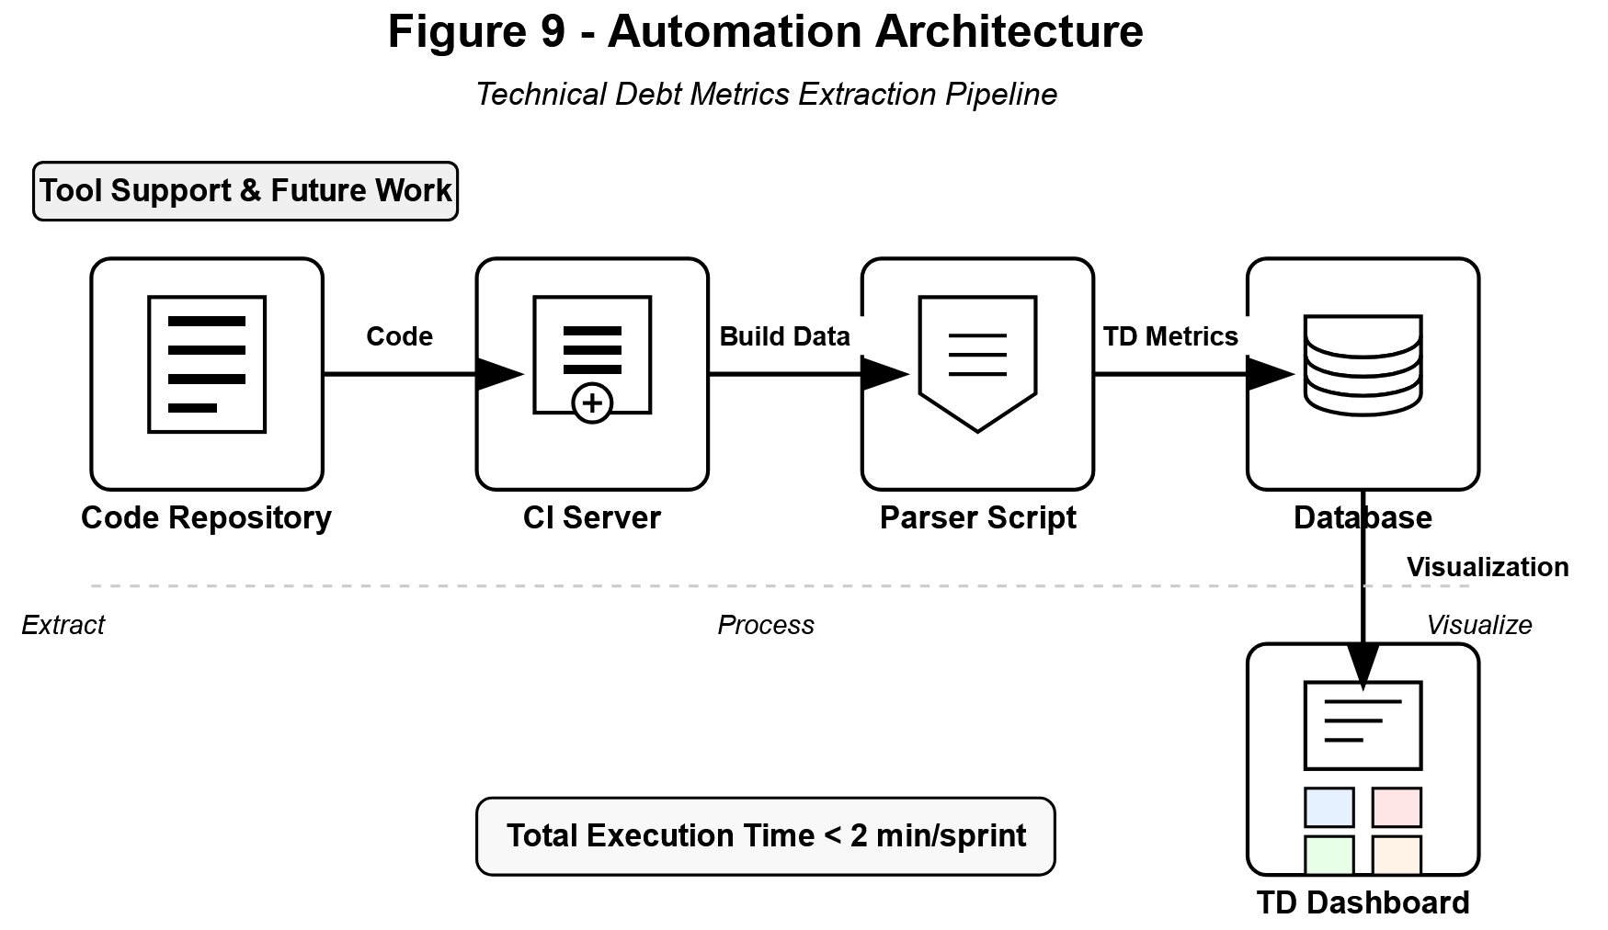
Automation architecture enhancements for improved scalability
Case Study – Fintech Database Integration (part 4/4)
Notes:
With better automation practices introduced, the software became easier to update and manage long-term, significantly boosting scalability and reducing future costs.

Slide 14
Summary of RESEARCH QUESTIONS answered
Q1 – Organisational & communication barriers to TD management
Q2 – Metrics to measure TD impact on velocity, quality, team performance
Q3 – Scenario‑Based Development (SBD) as integrative solution
Identified clear reasons why teams struggle with Technical Debt
Created practical, clear ways to measure debt impact
Demonstrated Scenario-Based Development’s real-world benefits
Notes:
We answered key questions by clearly identifying team challenges, developing simple metrics, and demonstrating the real benefits of using Scenario-Based Development.
Underlined:
Our findings emphasize the critical importance (strategic value) of structured TD management.

Slide 15
Conclusions & future directions
Contributions:
effective, easy-to-use Technical Debt management approach with measurable benefits
Future plans:
broader validation, automation, real-time Agile integration
Notes:
In conclusion, our structured approach provides measurable, actionable strategies for managing Technical Debt effectively.
Looking forward, our future efforts will focus on testing our approach across more teams, creating automated tools, and integrating this method deeper into Agile workflows.
Our next steps? World domination—starting with better code and fewer bugs.

Slide 16
Q&A and contact info.
Questions?
sabina@bridgein.tech,
radu.constantinescu@ie.ase.ro,
antonio.clim@csie.ase.ro
Notes:
Thank you for your attention.
We welcome your questions and further dialogue.
Now, any questions? Preferably easy ones—I left my crystal ball at home.
Maybe (why not) we would find/explore some collaborative opportunities together.

Slide 17
Q&A – anticipated (proactive approach) 1
Q1: How do you validate the cost estimates without historical baselines? | We triangulated bottom-up developer estimates with ex-post ticket data and Monte-Carlo sensitivity checks (cf. Alves et al. 2014). Median absolute deviation was 8 %.
Q2: Does SBD scale to large monoliths or only micro-services? | The framework is technology-agnostic. What changes is granularity: scenarios map to modules in monoliths or bounded contexts in micro-services. Empirical cases included both.
Q3: How is your approach different from SonarQube’s TD index? | SonarQube yields code-level remediation effort. Our metrics integrate scenario value and project economics, enabling cross-role negotiation rather than a single technical score.

Slide 18
Q&A – anticipated (proactive approach) 2
Q4: Could the observed quality gains be due to Hawthorne effect? | We mitigated by sustained observation over four release cycles (> 9 months) and by including control teams that did not adopt the framework; their metrics showed no comparable improvement.
Q5: What is the main threat to external validity? | Organisational culture: all teams had moderate Agile maturity; highly regulated or waterfall-centric contexts may require tailoring, which we list in Section 4.
Q6: How much overhead does the data collection add per sprint? | Teams reported ≈ 1 h per sprint (scrum master + tech lead) once templates were in place – < 3 % of average sprint capacity.

Slide 19
Q&A – anticipated (proactive approach) 3
Q7: Can interest be negative (i.e., cost decreases)? | Yes; rare but possible when market-driven refactoring renders previous architecture obsolete. Framework flags such cases, preventing unnecessary remediation.
Q8: Did you measure developer satisfaction? | Yes – a 7-point Likert survey showed a statistically significant +0.6 improvement (p < 0.05) in autonomy & clarity sub-scales.
Q9: How do you treat architectural vs. code-level debt? | We classify debt items by scope; architectural items are linked to multiple scenarios and cost/interest are proportionally allocated via expert elicitation (Delphi rounds).

Slide 20
Abbreviation List:
TD – Technical Debt
Shortcuts or quick solutions in software development causing extra maintenance and higher future costs.
SBD – Scenario-Based Development
A structured method connecting real user scenarios directly to software management and development tasks.
Story Cost
Estimated basic effort (Agile story points, typically Fibonacci numbers: 1, 2, 3, 5, 8, 13, 21...) required for developing a new feature without resolving Technical Debt.
TD Cost – Technical Debt Cost
Effort needed (in Agile story points) to resolve a specific Technical Debt issue separately from developing new features.
Story Cost with TD fix
Combined effort estimation (using Agile story points) for resolving existing Technical Debt while simultaneously developing a new feature.

Slide 21
Abbreviation List:
Interest (in Technical Debt context)
Extra future effort (in Agile story points) incurred if Technical Debt resolution is delayed.
NPS – Net Promoter Score
A measure of team or customer satisfaction based on the likelihood they recommend the product, team, or practice to others.
CI/CD – Continuous Integration/Continuous Delivery Automated software development practices to frequently integrate and reliably deliver software changes.
Agile (implicitly relevant)
A flexible software development approach emphasizing collaboration, iterative development, and responsiveness to change.
KLOC – Thousand Lines of Code
A measure often used in software engineering to indicate software size or complexity, typically counting thousands of lines of code.

